Slide 1
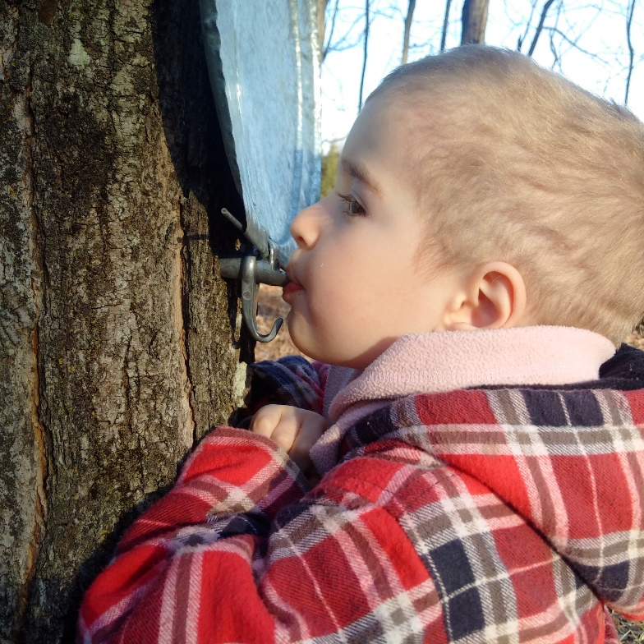
Environnement prénatal et autisme
Larissa Takser, MD, PhD
Université de Sherbrooke

Slide 2
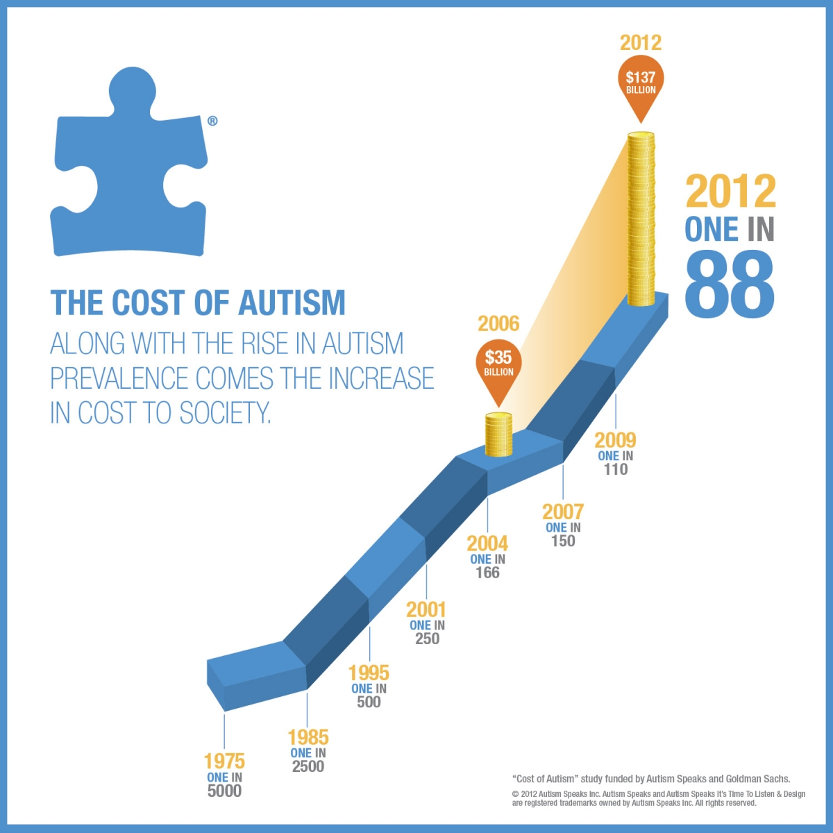
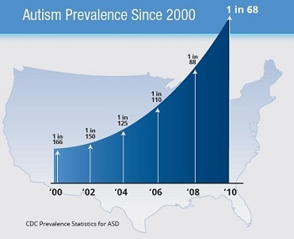
Source: Autism Speaks and CDC
Notes:
The prevalence of autism is also increasing in NA.
In 2010, one 8-year aged child per 68 has the diagnosis of ASD.
It is common to think that this increase is due to increased awareness, but the dynamic of the prevalence was the same for the last 10 years.
And, in according to an extensive review by Nature, for 46% of the increase there is no any explicative hypothesis.

Slide 3
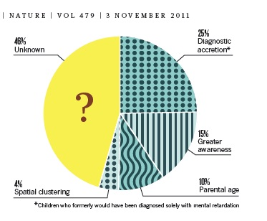

Slide 4
Developmental Origin of Health and Diseases (DOHaD)
exemples | risque augmenté
Dutch famine | Maladies cardiovasculaires, obésité, schizophrenie
Fetal alcohol syndrome | Déficience intellectuelle
DES | Cancer et infertilité dans la 2ème et 3ème générations
Méchanisme:
épigénétique (“mémoire” de l’ADN)

Slide 5
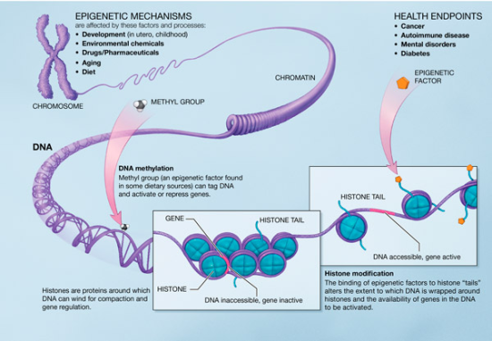
Épigénétique: point de rencontre entre la génétique et l’environnement
Folates, choline
http://healthandenvironmentonline.com/2012/10/12/epigenetics-and-the-developmental-origins-of-disease/

Slide 6
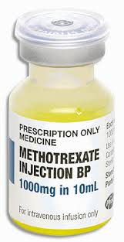
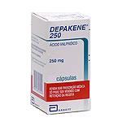
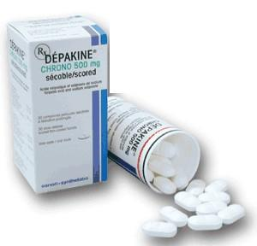
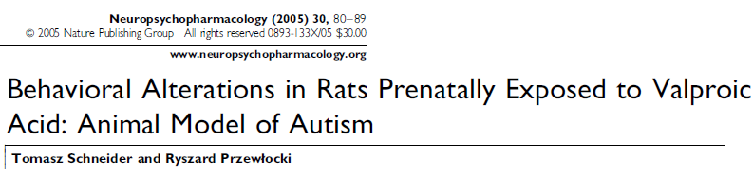
Two drugs trigger the development of autism
Anti-folate
Intrathecal exposure → autistic traits in previously neurotypic child

Slide 7
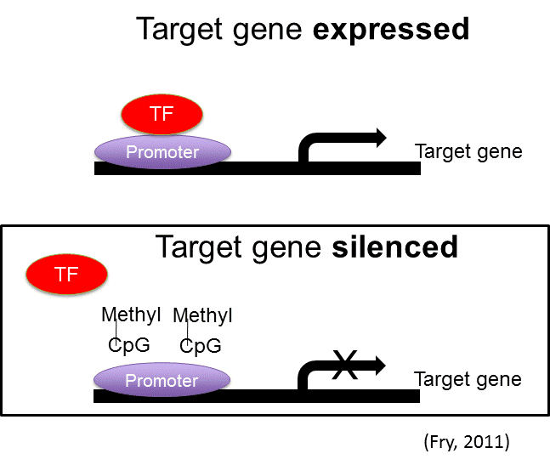
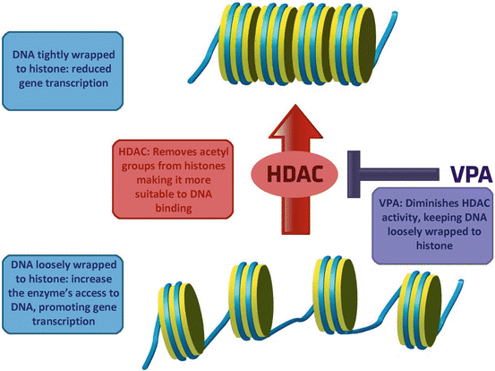
Méthylation et acétylation
↓ FOLATE
Déficit Folates
Acide Valproique
Défaut de méthylation
Surplus d’acétylation
Surexpression de gènes

Slide 8
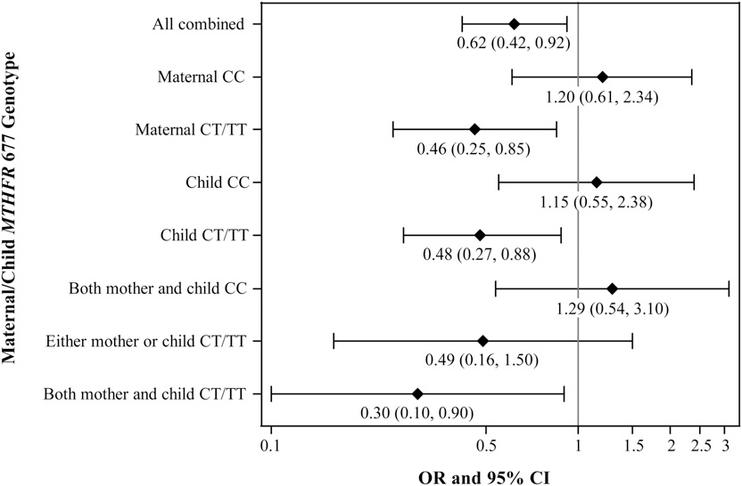
L’acide folique et le risque d’autisme,
Selon le polymorphisme MTHFR
Schmidt, et al. 2012. Étude CHARGE

Slide 9
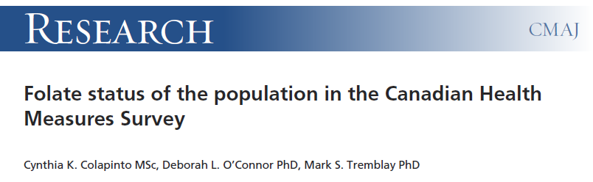


Slide 10


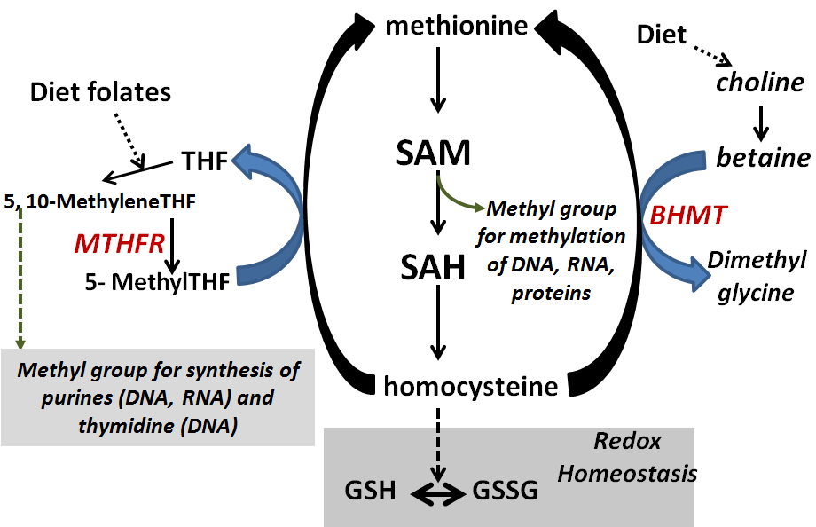
Autism: is folate deficiency one of the causes?
Strong epidemiological evidence:
Folate deficiency
Nutritional
Functional
(MTHFR polymorphism, anti-folate receptor ab)
⇑ Risk of autism

Slide 11
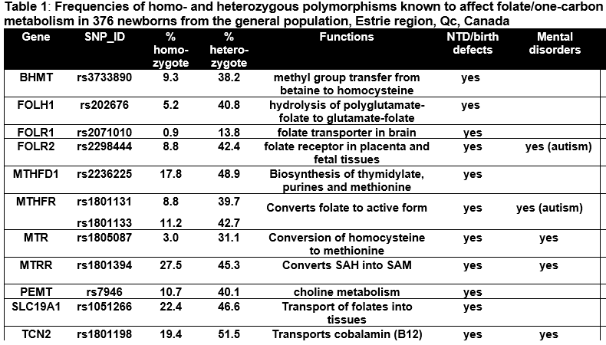

Slide 12
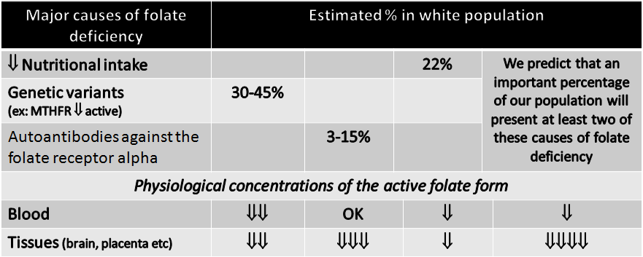
Autres conditions qui diminuent la biodisponibilité des folates:
Obésité, antibiotiques, alcool, NSAID

Slide 13
Epidemiology: potentially modifiable risk factors for autism or autistic traits
Risk factors | Potential mechanism
Endocrine disruptors: flame retardants PBDE and phthalates in pregnancy | Testosterone and/or aromatase brain pathways Thyroid disruption
Inadequate folate intake in early pregnancy | Epigenetic over-regulation of gene expression / methylation of DNA
Overweight/obesity in pregnancy GI disfunction in early childhood | metabolic pathways, gut microbiome? Trypthophan metabolism? Impaired early gut colonisation?
Refs: Kim et al. 2009; Engel et al. 2010; Miodovnik et al. 2011; Braun et al. 2009; Whyatt et al. 2012; Kim et al. 2011; Gump et al. 2014; Chen et al. 2014; Gascon et al. 2011; Hoffman et al. 2012; Adgent et al. 2014; Schmidt et al 2013 CHARGE study; Suren et al 2013 MoBa study; Collado et al 2010; Puspogenoro et al 2015

Slide 14
Method
Folate deficiency (diet + SST)
Behavioral testing
SuccinylSulfaThiazole 1% (SST)
Mixture
(DEHP, DBP, DiNP: 4,5 mg/kg/d;
BDE-47, BDE-99:
20 µg/kg/d)
VPA (600mg/kg @GD12)
mating
birth
Tests | Age | behavior
Nest-seeking | P8 | Recognition of maternal odor
Open field | P20 | Locomotor activity / Exploration
Elevated Plus Maze | P25 | Exploration / anxiety
Prepulse Inhibition Marble burying | P35 P30 | Sensorimotor gating Repetitive/stereotypic behavior
Social interactions | P40-45 | Communication, playing

Slide 15
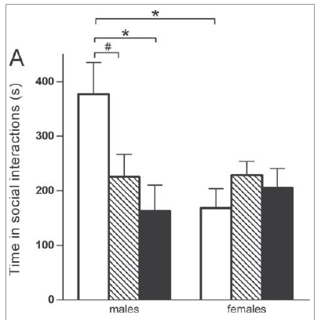
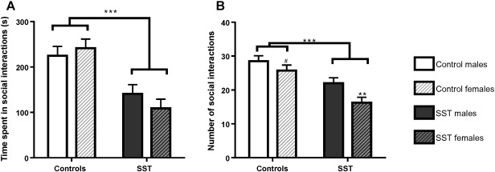
Social interactions
PBDE+phthalates vs VPA
Periconceptional antibiotic
Folate deficit

Slide 16
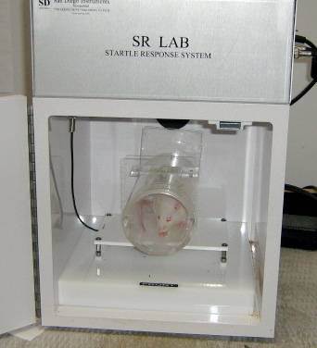
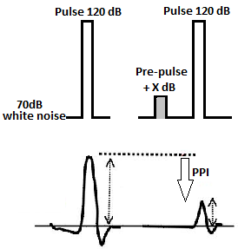
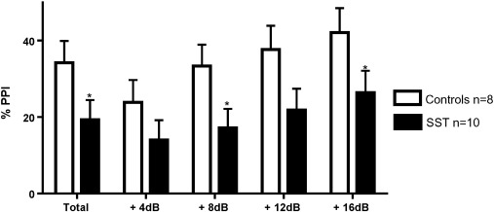
Sensorimotor gating in offspring exposed to impaired maternal gut microbiome

Slide 17
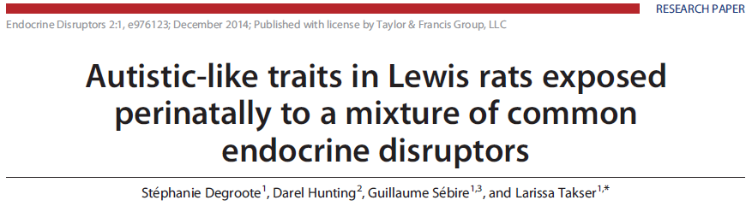
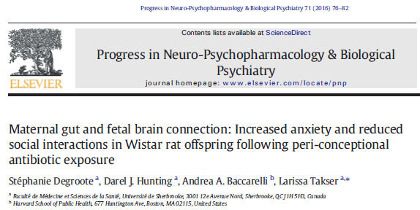
ASD phenotype in rat model
 | Endocrine disruptors | Folate deficit | Antibiotic /gestation |  | Valproic acid
Recognition of maternal odor | ä ♂ |  |  |  | ä ♂
Locomotor activity (open field) | ã | ns | ns |  | ã
Anxiety (elevated plus maze) | ns | ã | ã |  | ã
Social interactions | ä ♂ | ä | ä |  | ä ♂
Sensorimotor gating (PPI) | ns | ä | ä |  | ns
Stereotypic behavior (Marble burying) |  | ã | ns
Other | Escaping | Increased homocysteine Congenital malformations | No change in tryptophan/serotonin levels in dams |  | Developmental delay

Slide 18
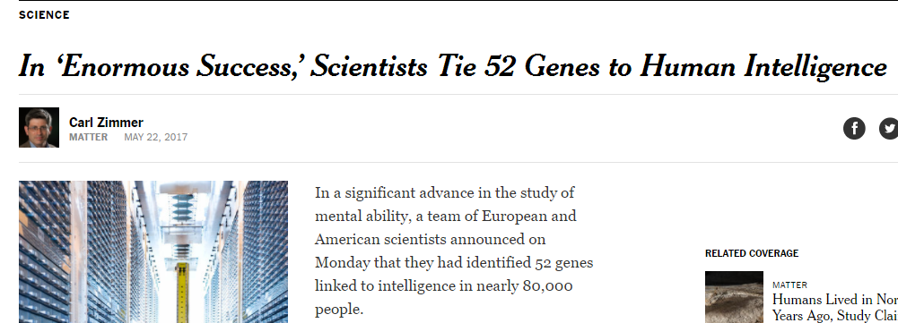
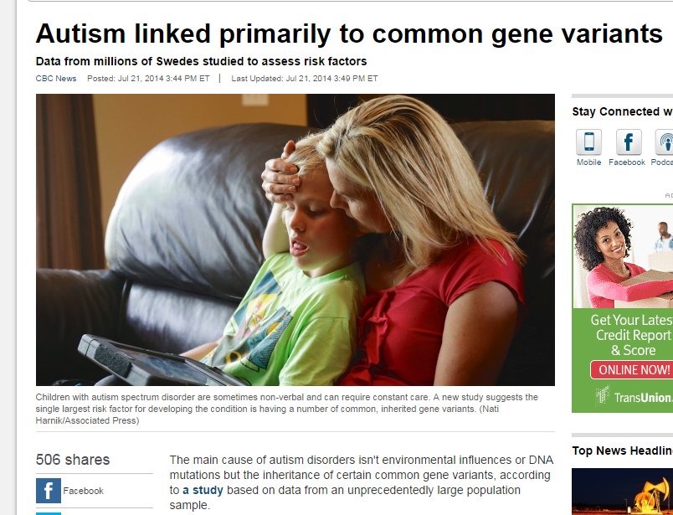
“These genes do not determine intelligence, however. Their combined influence is minuscule, the researchers said, suggesting that thousands more are likely to be involved and still await discovery. Just as important, intelligence is profoundly shaped by the environment.”

Slide 19
Gene A
+
exposure
= outcome
experimental
populational
Gene A
Gene A
Gene B
No exposure
exposure
exposure
conclusion
Cause: environment
Cause:
genetics

Slide 20
Conclusions
Développement des compétences sociales est facilement influencé par l’environnement chimique prénatal
Différentes perturbations convergent vers un phénotype semblable à celui des troubles autistiques non syndromiques
Déficience fonctionnelle en folates durant embryogenèse pourrait expliquer un nombre important des cas de l’autisme. La prévention de l’autisme serait donc faisable.

Slide 21

Merci pour votre attention!

